Slide 1


SAVEETHA SCHOOL OF ENGINEERING SAVEETHA INSTITUTE OF MEDICAL AND TECHNICAL SCIENCES CHENNAI-602105
C05 AT2 - TECHNICAL PRESENTATION
MULTI AGENT SYSTEMS AND THEIR APPLICATIONS
CSA1714 – ARTIFICIAL INTELLIGENCE
Guided By
Dr. NAGARAJAN B
Presented By
DHARSHAN B (192312150)

Slide 2
INTRODUCTION
A Multi-Agent System (MAS) consists of multiple intelligent and autonomous agents working in a shared environment.
Each agent can sense, process information, make decisions, and perform actions independently.
Agents communicate with one another to exchange information and coordinate activities.
The agents may cooperate, negotiate, or compete depending on the application.
MAS is mainly used to solve complex, distributed, and large-scale problems.

Slide 3
WHAT IS INTELLIGENT AGENT?
An intelligent agent is a software or hardware entity capable of autonomous decision-making.
It collects information from the environment using sensors, data sources, or communication networks.
The agent processes the information using rules, algorithms, AI, or machine learning.
It selects the most suitable action based on its goals, knowledge, and current situation.
Examples include robots, virtual assistants, autonomous vehicles, and monitoring systems.

Slide 4
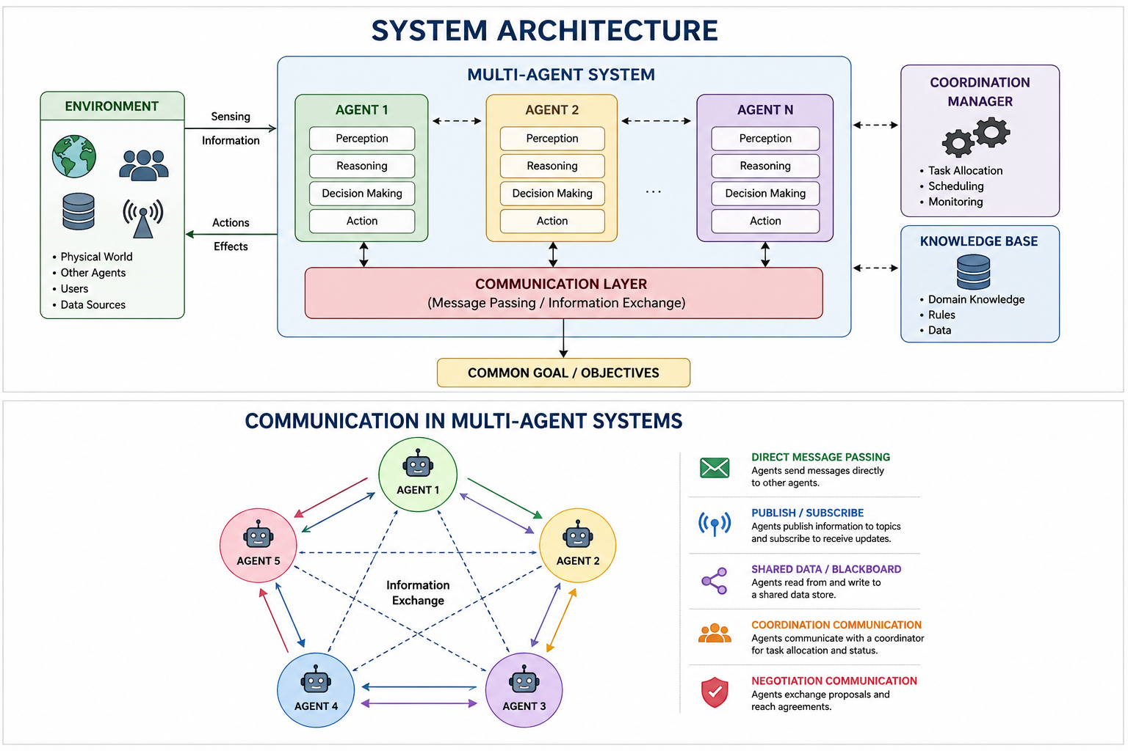
SYSTEM ARCHITECTURE
Environment: Provides information and conditions for agents.
Agents: Perform sensing, processing, decision-making, and actions.
Communication: Enables information and data exchange between agents.
Coordination: Allocates tasks and manages interactions.
Objective: Agents work toward common or individual goals.

Slide 5
TYPES AND CHARACTERISTICS OF AGENTS
Types of Agents
Reactive Agent: Responds directly to environmental changes.
Deliberative Agent: Uses reasoning and planning before acting.
Learning Agent: Improves its behavior using experience and data.
Goal-Based Agent: Takes actions to achieve predefined objectives.
Hybrid Agent: Combines reactive, planning, and learning capabilities.
Key Characteristics
Autonomy • Communication • Cooperation • Adaptability • Decision-Making

Slide 6
COMMUNICATION AND COORDINATION
Message Passing: Agents exchange information directly.
Task Allocation: Tasks are distributed according to agent capabilities.
Cooperation: Agents combine their resources and knowledge.
Negotiation: Agents resolve conflicts and reach agreements.
Distributed Planning: Agents create coordinated plans to achieve objectives.

Slide 7
APPLICATIONS
Robotics: Used for swarm robots, warehouse automation, exploration, and collaborative robots.
Transportation: Supports traffic management, autonomous vehicles, route optimization, and fleet coordination.
Manufacturing: Agents coordinate machines, production schedules, inventory, and quality monitoring.
Healthcare: Used for patient monitoring, medical decision support, and hospital resource management.
Smart Grid: Agents manage distributed energy sources, power demand, storage, and energy distribution.

Slide 8
ADVANTAGES AND CHALLENGES
Advantages
Parallel Processing: Multiple agents can perform tasks simultaneously.
Scalability: Additional agents can be introduced when required.
Fault Tolerance: Failure of one agent may not stop the complete system.
Flexibility: Agents can adapt to changing environments.
Resource Sharing: Agents can share information and computational resources.
Challenges
Communication overhead
Coordination complexity
Conflicting objectives
Security and reliability
High computational requirements

Slide 9
CONCLUSION
MAS enables multiple intelligent agents to work autonomously and collaboratively.
Communication and coordination are essential for effective agent interaction.
MAS provides distributed decision-making and parallel task execution.
It is widely applicable in robotics, transportation, manufacturing, healthcare, and energy systems.
Integration with AI, Machine Learning, IoT, and autonomous systems will expand its future applications.

Slide 10


